Slide 1

FOSS4G GLOBAL 2026 · ACADEMIC TRACK · HIROSHIMA
Comparative Analysis of Route and Health Care Facilities for the Emergency Patients of Pune and Bengaluru
Adwait Priyadarshan
4th Year Integrated-MTech(BTech + MTech) CSE Student IIIT-Bangalore
Adwait.Priyadarshan@iiitb.ac.in
Manish Kumar Mishra
Environmental Monitoring & Assessment Division, BARC, Mumbai
manishkm@barc.gov.in
Open-source · QGIS · OpenStreetMap · GHSL · PyGIS
How road-network morphology decides who reaches a hospital in time
Notes:
Open with the question: when an ambulance is called, does the city's road layout decide whether the patient arrives in time? Two Indian megacities, same method, opposite morphologies. 20 slides, 20 minutes - about a minute each. Do not overrun on the early slides.

Slide 2
THE PROBLEM
Fast urban expansion and vehicle uses have created severe spatial strain on critical infrastructure.
How much of a city can an ambulance actually reach in time?
TomTom Traffic index 2025 Global Ranking 2
Flat Deccan Plateau
Radial and Grid streets
A sponge
BENGALURU
1
1
Survival in Trauma and Cardiac emergencies is measured in minutes, not kilometres.
Outcome is highly dependent on “Time”
2
Service areas are drawn as radii around hospitals. Under real traffic, reach follows road network instead & the loss could not be quantified for these cities from open data.
Congestion breaks the catchment
PUNE
TomTom Traffic Index 2025 Global Ranking 5
Sahyadri foothills
Split by the Mula and Mutha
A collapsing tree
3
Whether road-network structure decide how much of a city is reachable in 5, 10 and 15 minutes — and how much of the population is left outside?
The unanswered question
2
Notes:
The claim: the difference between these cities is not budget or hospital count. It is the shape of the network.

Slide 3
STUDY AREA
Profiling the Two Megacities for Comparative Analysis
Parameter | BENGALURU | PUNE
Area | 710 km² | 742 km²
Road length | 16,310 km | 10,662 km
Road density | 22.97 km/km² | 14.37 km/km²
Emergency Hospitals | 62 | 55
Morphology | Radial + grid | Dendritic
The Equity Correction
Pimpri-Chinchwad (extended city, 1.7 Million) was merged into the Pune boundary so both study areas are comparable in extent — 742 km² against 710 km².
Without this, the comparison would reward Bengaluru for size alone.
3
Notes:
Emphasise the equity correction. It is the difference between a fair comparison and an artefact of boundary size, and reviewers ask about it.

Slide 4
DATA
Everything open and Reproducible
1 | Road network | OpenStreetMap via QuickOSM | Primary · secondary · tertiary · residential, etc. merged into a single road network
2 | Hospitals | OSM, manually verified | 62 Bengaluru, 55 Pune — emergency-capabilities only
3 | Boundaries | Datameet municipal repository (https://github.com/datameet/Municipal_Spatial_Data ) | GeoJSON converted to GeoPackage
4 | Population | GHSL gridded estimates | Satellite imagery with census integration
5 | Traffic | TomTom Move, August 2024 (https://move.tomtom.com ) | GeoJSON → GPKG, snapped at 10 m to road segments

Slide 5
THE CONGESTION INDEX
Defining Cᵢ
Table 1 · Free-flow speed by OSM road hierarchy
Cᵢ = 1 − (harmonic_speed / baseline_speed)
Road category | km/h
Motorway | 60
Trunk | 55
Primary | 45
Motorway link | 40
Trunk link | 35
Secondary | 35
Road category | km/h
Primary link | 30
Secondary link | 25
Tertiary | 25
Residential | 20
Tertiary link | 20
Service | 15
bounded [0, 1]: 0 = free-flow, 1 = stopped
harmonic_speed — TomTom harmonic average speed, measured from probe vehicles over August 2024.
baseline_speed — TomTom's per-segment reference speed for that road.
Two Related Reference
Cᵢ : From TomTom.
The travel-time speeds come from the OSM road hierarchy (Table 1). This keeps the routing model reproducible from open data alone — TomTom supplies only the relative slowdown.
Conservative assumption
TomTom observes arterials. Streets without adequate observation are assigned Cᵢ = 0 — held at free-flow. This avoids inflating last-mile times and identifies the arterial network as the true bottleneck.
6
Notes:
The Ci = 0 assumption is the most likely audience question. Answer: it is deliberately conservative. TomTom probe coverage is arterial; assuming free-flow on residential streets under-states delay rather than inventing it.

Slide 6
METHOD
From raw OSM to a congestion-weighted routing network
1
2
3
4
5
Merge road
classes
›
Join attributes by Nearest
at 10 m
›
Reproject to
UTM 43N
›
Weight travel
time
›
Build
isochrones
Why isochrones? not buffers
A deterministic travel-time model
Normal_Time = Segment_Length / Normal_Speed
Dynamic_Speed = Normal_Speed / (1 + Cᵢ)
Dynamic_Time = Normal_Time × (1 + Cᵢ)
A 5 km circle assumes straight-line travel — it ignores the road network entirely.
Isochrones map what is actually reachable in a given number of minutes.
Converted to concave hulls at α = 0.01, checked against lakes and open land.
No black-box routing API — the model is visible and reproducible.
5
Notes:
Stress the deterministic formula. A mapping API would hide the congestion model inside someone else's algorithm and make the result unreproducible.

Slide 7
NETWORK COMPOSITION
Ninety per cent (90 %) of both networks is Residential & Service road
The asymmetry
92,400
Residential segments in Bengaluru
42,344
in Pune — less than half
Bengaluru's interconnected minor streets are the detours that absorb arterial congestion. Pune's arterials carry the load alone.
7
Notes:
Both cities look similar in proportion - roughly 90 percent minor roads. The difference is absolute count, and that is what creates redundancy.

Slide 8
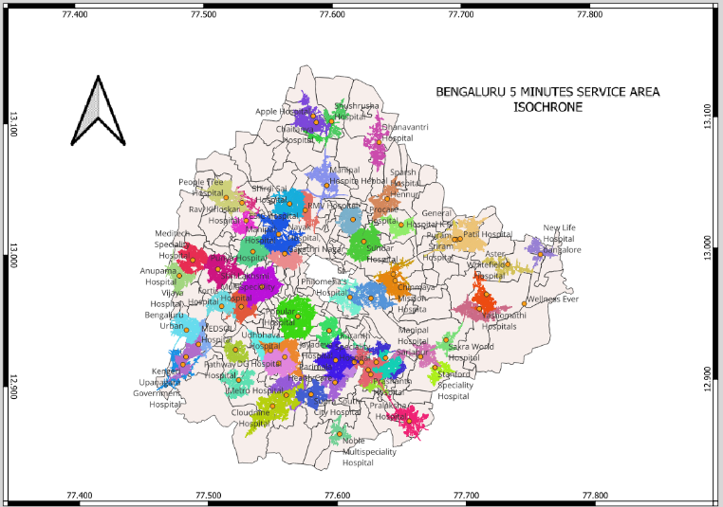
BENGALURU · 5-MINUTE SERVICE AREA
Broad, overlapping reach from 62 hospitals
Salient features
Reach spreads outward in all directions from each hospital.
Catchments overlap — most areas are served by more than one facility.
Gaps sit at the periphery, not inside the built-up core.
MAP PLACEHOLDER — Figure 7
5-minute service area isochrone, Bengaluru
(traffic-integrated, hospitals as points)
8
Notes:
Insert Figure 7. Talk to the shape, not the legend: reach spreads in all directions, and catchments overlap - that overlap IS the redundancy.

Slide 9
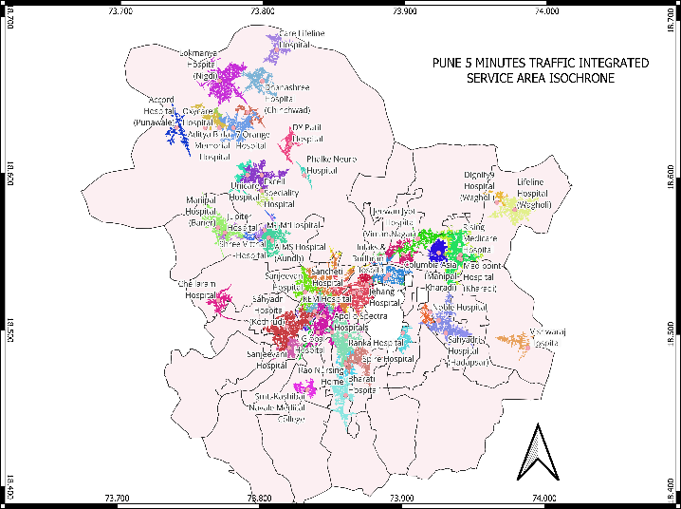
PUNE · 5-MINUTE SERVICE AREA
The same method, a very different shape
Salient Features
Reach stretches along corridors instead of spreading.
River crossings act as forced bottlenecks.
Southern and northern sectors fall outside the reachable area.
MAP PLACEHOLDER — Figure 8
5-minute service area isochrone, Pune
(same symbology and thresholds as the previous slide)
9
Notes:
Insert Figure 8. Say out loud that the symbology and thresholds are identical to the previous slide - otherwise the visual comparison means nothing.

Slide 10
RESULT · COVERAGE
Bengaluru absorbs congestion
99.2%
of population reached in 15 minutes, even with traffic
Near about 1%
population penalty from congestion at 15 minutes
Detours do the work. The 15-minute figure barely moves when congestion is applied.
10
Notes:
At five minutes congestion bites hard - 70 percent down to 47 percent. But by fifteen minutes the network has routed around it.

Slide 11
RESULT · COVERAGE
Pune cannot
88.8%
of population reached in 15 minutes with traffic
5.14%
population penalty — four times Bengaluru's
Roughly one in nine residents remains beyond reach after fifteen minutes.
11
Notes:
The five-minute area figure is the one to dwell on: 15.3 percent under traffic, roughly half Bengaluru's. Same method, same sources, very different city.

Slide 12
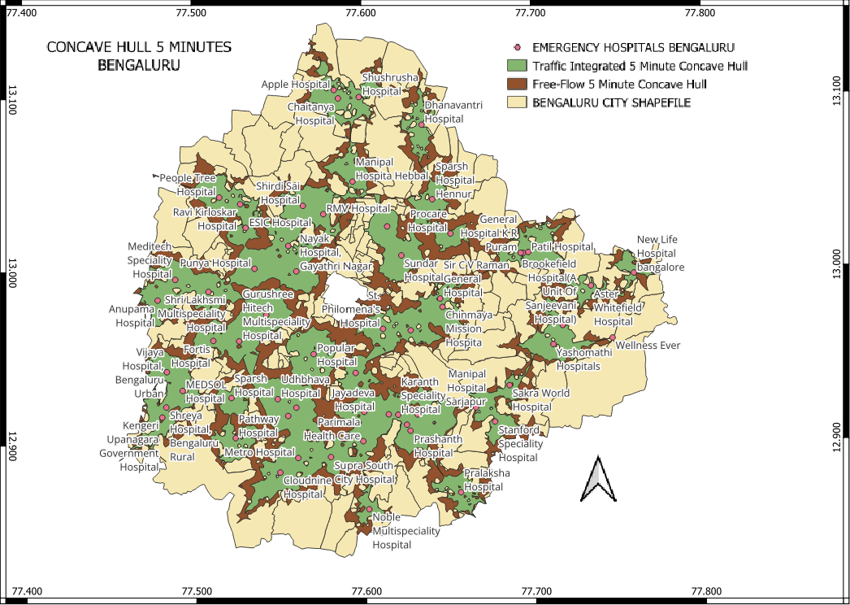
BENGALURU · CONCAVE HULL
Free-flow against traffic-integrated reach
Reading the map
The two hulls stay close together — congestion costs little reach.
Hulls are broad and rounded, following the grid.
α = 0.01 avoids the over-generalisation of a convex hull.
MAP PLACEHOLDER — Figure 10
5-minute concave hull, Bengaluru
(free-flow vs traffic-integrated, α = 0.01)
12
Notes:
Insert Figure 10. The gap between the two hulls is the visual measure of congestion cost - small here.

Slide 13
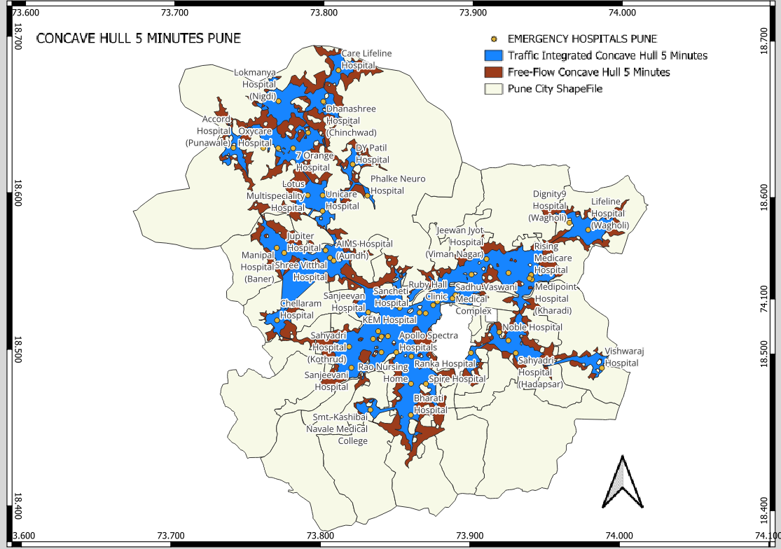
PUNE · CONCAVE HULL
The gap between free-flow and reality is much wider
Reading the map
A visibly larger gap between the two hulls.
Hulls are thin and branch-shaped — one route, no alternative.
Area coverage falls from 24.5 % to 15.3 % at five minutes.
MAP PLACEHOLDER — Figure 9
5-minute concave hull, Pune
(free-flow vs traffic-integrated, α = 0.01)
13
Notes:
Insert Figure 9. Contrast the SHAPE with the previous slide - branches versus blobs. That shape difference is the whole argument in one picture.

Slide 14
COMPARISON
The cost of congestion (Quantification)
Parameter | BENGALURU | PUNE
Total network length | 16,310.59 km | 10,662.19 km
Study area | 710 km² | 742 km²
Road density | 22.97 km/km² | 14.37 km/km²
Total time lost | 108.05 h | 143.63 h
Average delay | 24.0 sec/km | 48.6 sec/km
City-wide penalty | 13.51 % | 26.15 %
Pune loses 35 more hours across its network and pays roughly twice the delay per kilometre — on a network two-thirds the length.
14
Notes:
Delay per kilometre is the fairest single comparison because it normalises for network size. Twice the delay, on a shorter network.

Slide 15
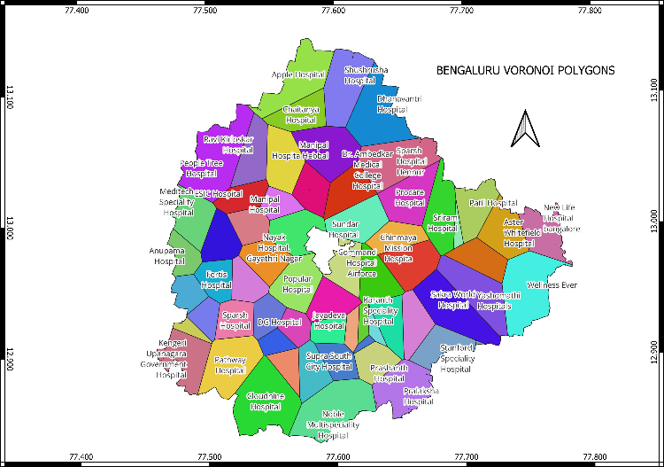
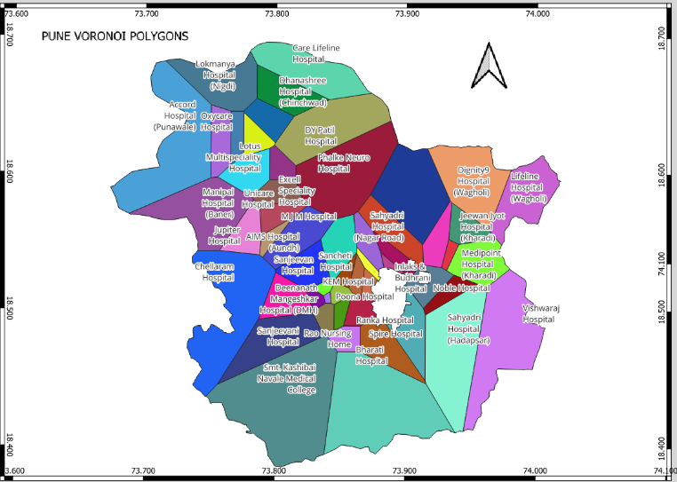
SPATIAL DOMINANCE
Hospital vs Population: Where the hospitals are - is not where the people are
MAP PLACEHOLDER — Figure 12
Bengaluru — hospital Voronoi catchments
MAP PLACEHOLDER — Figure 11
Pune — hospital Voronoi catchments
Compact catchments across central, southern and western zones. Gradual transition outward — peripheries thinner but not abandoned.
Rigid clustering in the western-central core, then a cliff. Southern catchments are extremely large — an underserved distress zone.
Bengaluru's gap is at the outskirts; Pune's is structural and reaches into the city.
15
Notes:
A large Voronoi polygon means one hospital is responsible for a large area - which is exactly where emergency response fails.

Slide 16
INTERPRETATION
Sponge versus tree
THE SPONGE
THE TREE
Bengaluru
Pune
Many interconnected minor streets
Blocked arterial ⇒ a detour exists
Congestion is diffused, not amplified
15-min penalty: Near 1 % of population
Few links; rivers and hills force crossings
Blocked arterial ⇒ no alternative
Congestion propagates along the whole branch
15-min penalty: 5.14 % of population
Redundancy is resilience. A network with alternatives degrades gracefully; one without fails all at once.
Notes:
The conceptual heart of the paper. If you are running short on time, this is the slide to slow down on - everything else supports it.

Slide 17
LIMITATIONS
What this analysis does not reflect
1.
One-way restrictions
OSM one-way attributes are incomplete. Emergency vehicles were allowed limited flexibility, which may overestimate reach where physical barriers exist.
2
Last-mile travel
Patient location, building entrances, internal lanes and pedestrian paths lie outside the routable network.
3
Unobserved segments
Streets without adequate TomTom coverage were assigned Cᵢ = 0, keeping the model deliberately conservative on minor roads.
4
Hospital tiering
Facilities were verified as emergency-capable, but tier classification was not possible from open data.
5
Single time window
Congestion is August 2024 historical. Seasonal and event-driven variation is not represented.
17
Notes:
Expect a question on the Ci = 0 assumption. The answer is that it is deliberately conservative for last-mile travel.

Slide 18
FUTURE WORK
Can network structure predict congestion where no traffic feed exists?
1
2
3
Quantify the morphology
Temporal vulnerability
Graph learning
Detour ratio, bridge fraction and load concentration turn 'sponge versus tree' into measurable numbers.
Hourly congestion data reveals when the network fails, not just whether — and how much population-time is exposed.
A graph neural network could infer congestion on the streets no probe vehicle observes, replacing the Cᵢ = 0 assumption.
If congestion can be learned from network structure, this analysis becomes available to every city with OSM coverage — including those with no commercial traffic feed at all.
18
Notes:
Frame this as an invitation, not a finished result. If anyone in the room works on graph learning or traffic, this is the slide that starts that conversation - stay in the room afterwards.

Slide 19
CONCLUSIONS
Redundancy is resilience
1
Morphology constrains equity
2
Delay is structural, not marginal
Bengaluru's grid absorbs congestion through detours — a 1.34 % population penalty at 15 minutes.
Pune's dendritic network amplifies delay — a 5.14 % penalty, roughly four times higher.
3
The gap is measurable
4
Open tools are sufficient
48.6 sec/km against 24.0 sec/km, on a network two-thirds the length.
QGIS, OSM, GHSL and open traffic data reproduce the entire analysis at no cost.
Hospital siting in a tree-like city must account for the fact that congestion cannot be routed around.
19
Notes:
Land on the policy implication. This is the sentence you want people to remember.

Slide 20
Thank you
QUESTIONS?
Adwait Priyadarshan
Adwait.Priyadarshan@iiitb.ac.in
IIIT Bangalore
Manish Kumar Mishra
manishkm@barc.gov.in
BARC Mumbai
Acknowledgements — Department of Computer Science and Engineering, IIIT Bangalore; Prof. Anshuman Singh, Department of Civil Engineering, NIT Patna.
Notes:
Leave this up for discussion. Have the sponge-versus-tree slide and the backup slide ready to jump back to.

Slide 21
BACKUP — NOT PART OF THE 20-MINUTE TALK
If asked: how were Pune's multiple time windows handled?
The situation
The correct aggregation
Bengaluru's export carries one time set covering 08:00–23:00.
Pune's carries fifteen — the same window, written out hourly.
Both cover the same month and the same daily hours.
v_eq = Σ nᵢ / Σ ( nᵢ / vᵢ )
Sample-weighted harmonic mean. Travel time is distance ÷ speed, so slow hours dominate the day — an arithmetic mean would understate delay.
Worked example — one Pune segment
15 hourly speeds: 6.3, 4.8, 6.7, 5.6, 7.4, 4.2, 4.0, 2.7, 4.4, 4.1, 3.8, 3.8, 4.2, 4.8, 8.6 km/h
first value only 6.30 arithmetic mean 5.03 harmonic mean 4.49 km/h
Note also that TomTom's time-set ids are not chronological — id 6 is 08:00–09:00 while id 2 is 09:00–10:00 — so selecting "the first result" silently picks a mid-morning hour. Aggregation avoids the problem entirely. This is a refinement for the follow-up work, not part of the published analysis.
Notes:
Only use this if asked directly. It describes a refinement planned for the follow-up study, NOT the method in the archived paper - say so explicitly if you show it.

